Slide 1
NBA 3 Point revolution using logistics regression
Mod 5 Presentation
Lim Zheng Wei

Slide 2
Intro
3 PT was first introduced in 1979.
Only 1 3 PT attempt(3PTA) during the 1979 NBA Finals
2017/18 Houston Rockets have more 3PTA than all the teams combined in the 1980s
Also the 1st NBA team in history to attempt more 3s than 2s
Players are more comfortable shooting from 3PT line and beyond

Slide 3



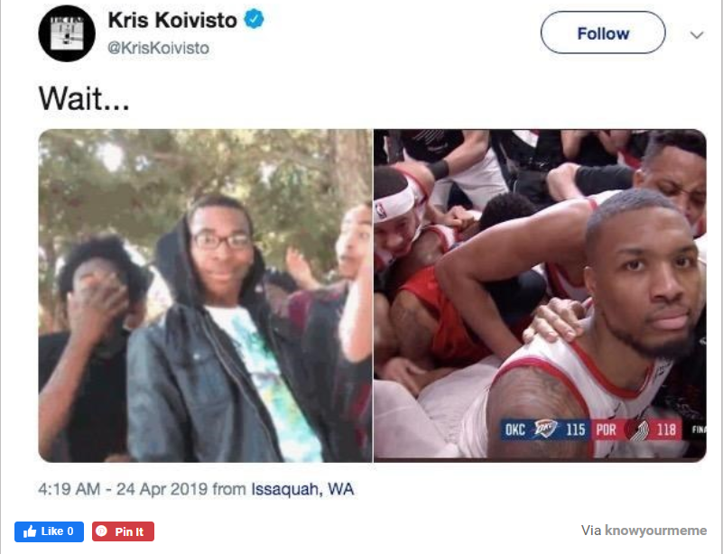

Slide 4
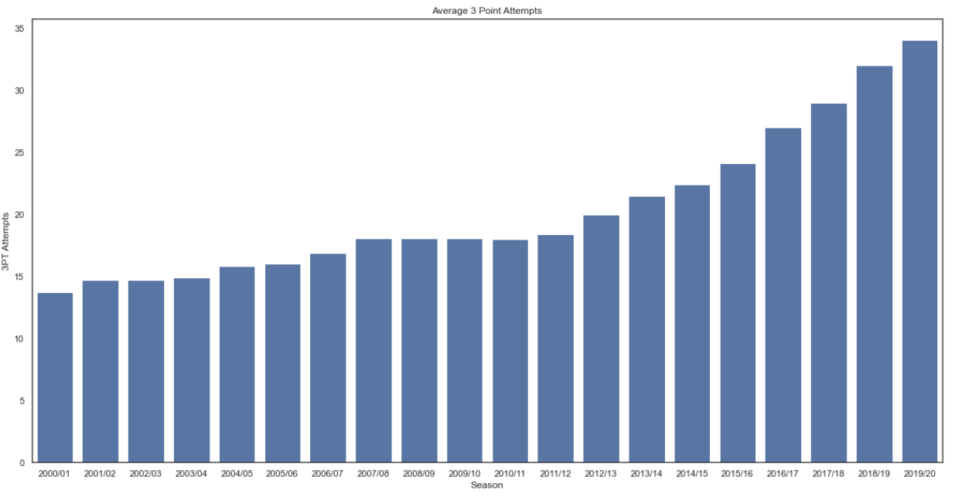

Slide 5
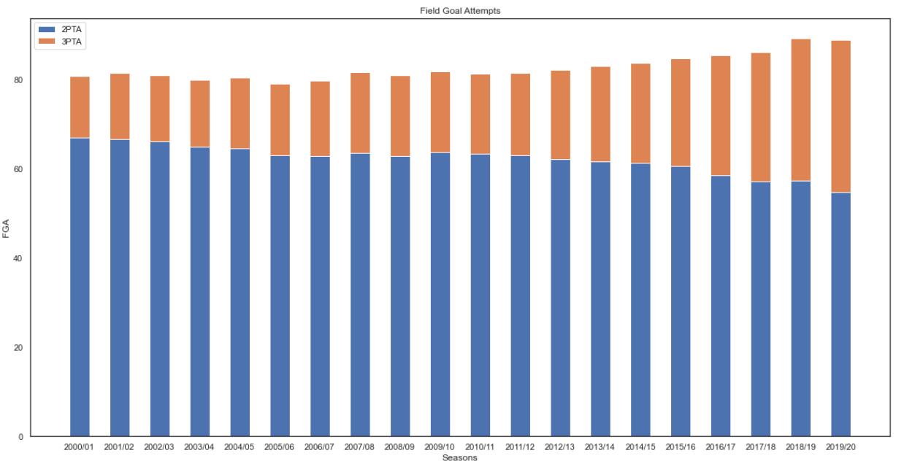

Slide 6
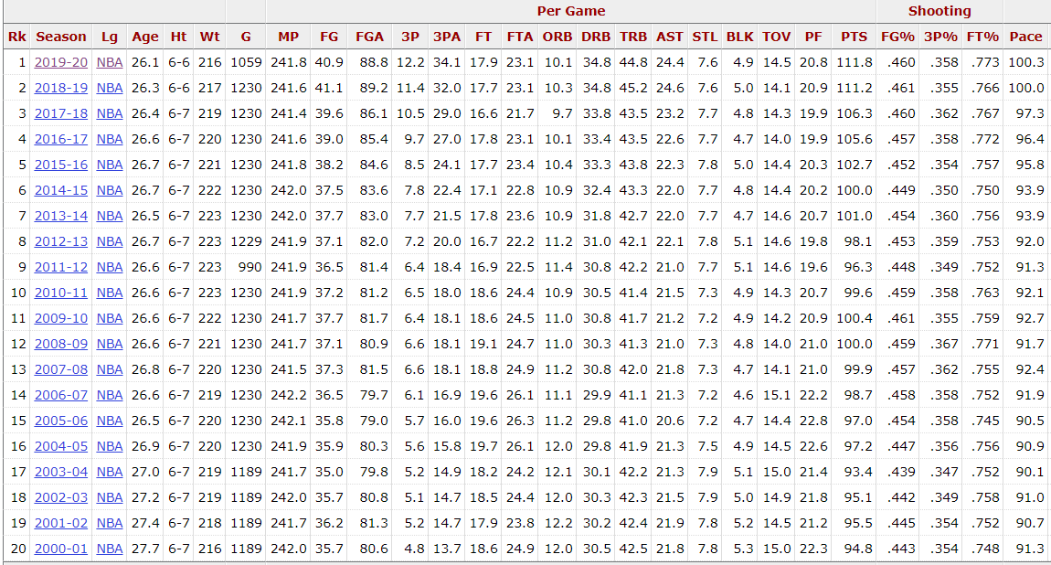

Slide 7
Why shoot more 3s?
Floor spacing
Allows non-shooters more room to operate/anyone to attack the paint
3 > 2

Slide 8
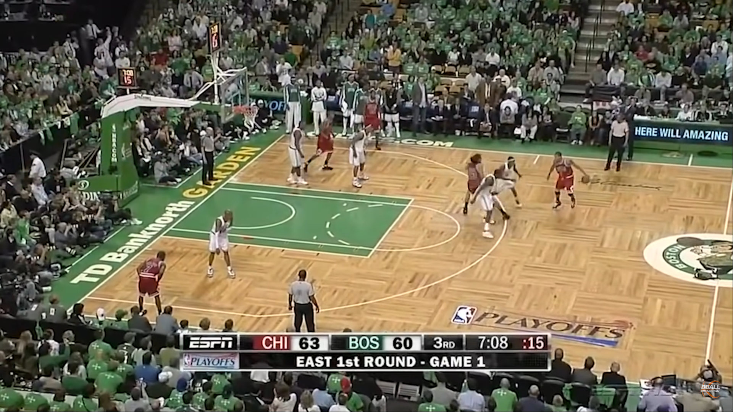
18 Apr 2009

Slide 9
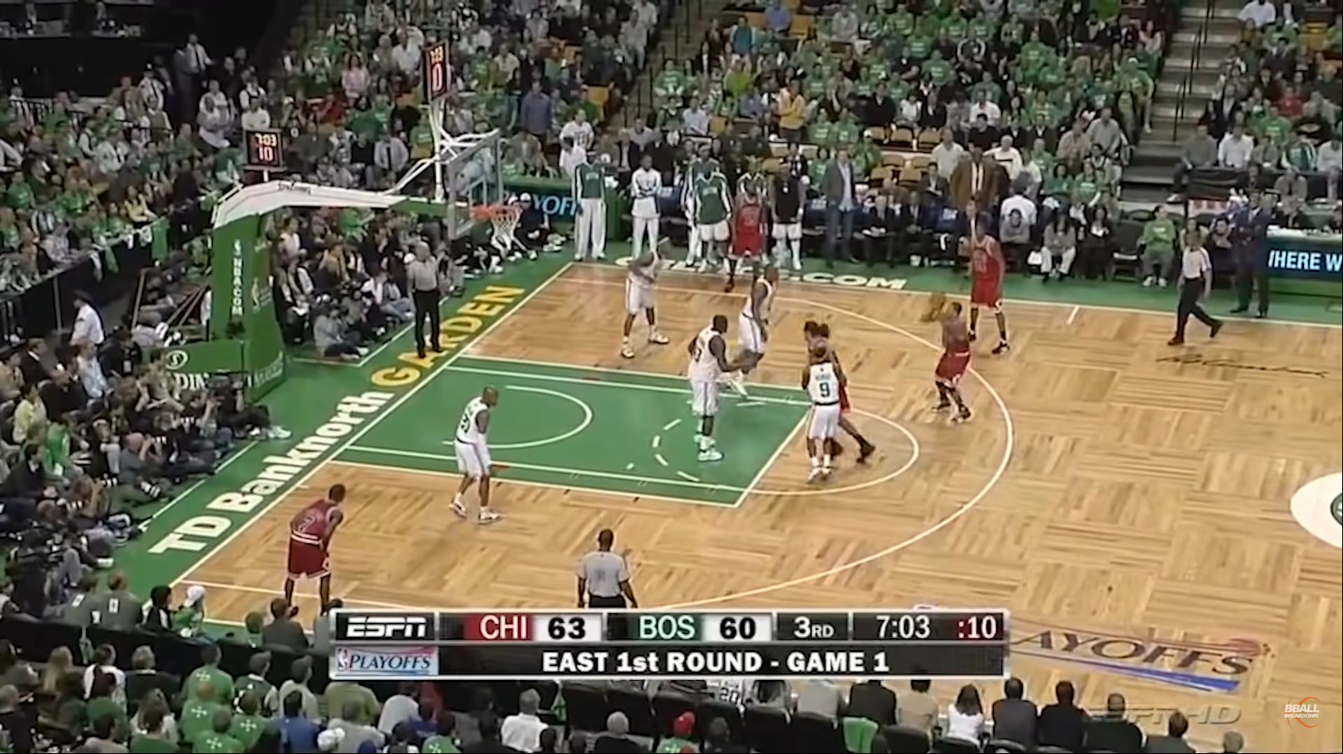
18 Apr 2009

Slide 10
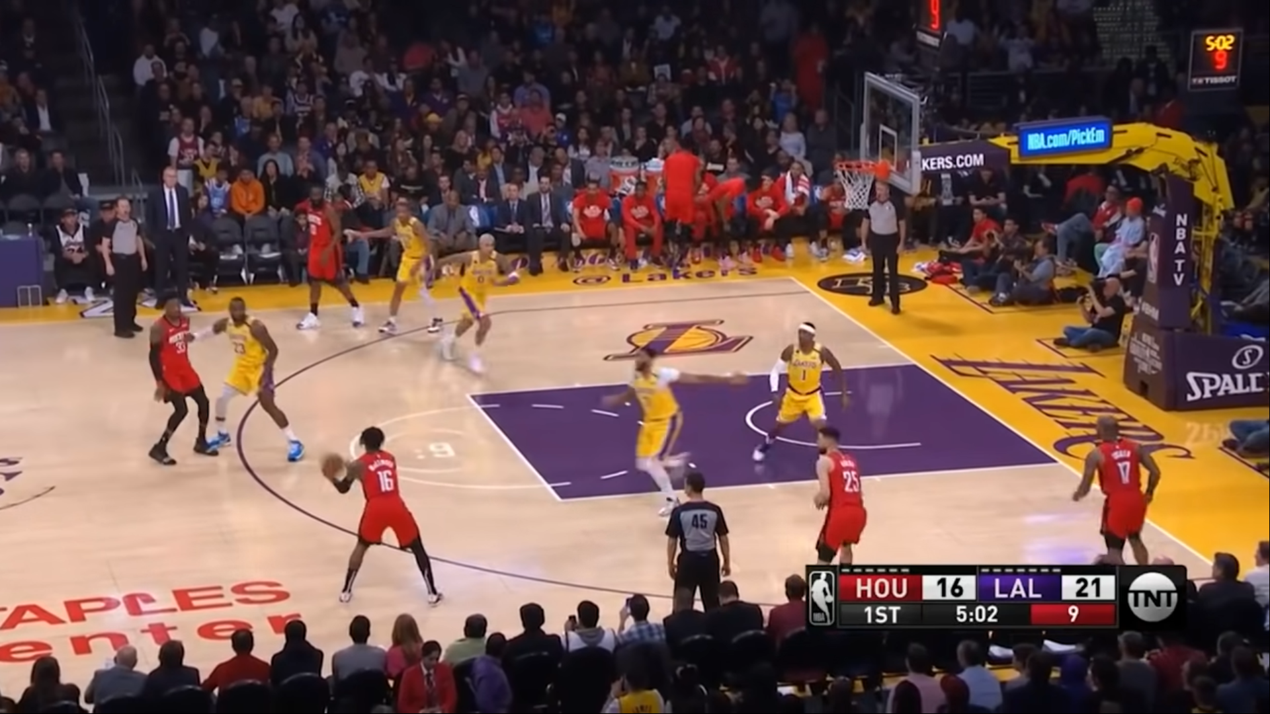
6 Feb 2020
Austin Rivers: 35.6%
Ben McLemore: 40%
James Harden: 35.5%
PJ Tucker: 35.8%
Robert Covington: 33.5%

Slide 11
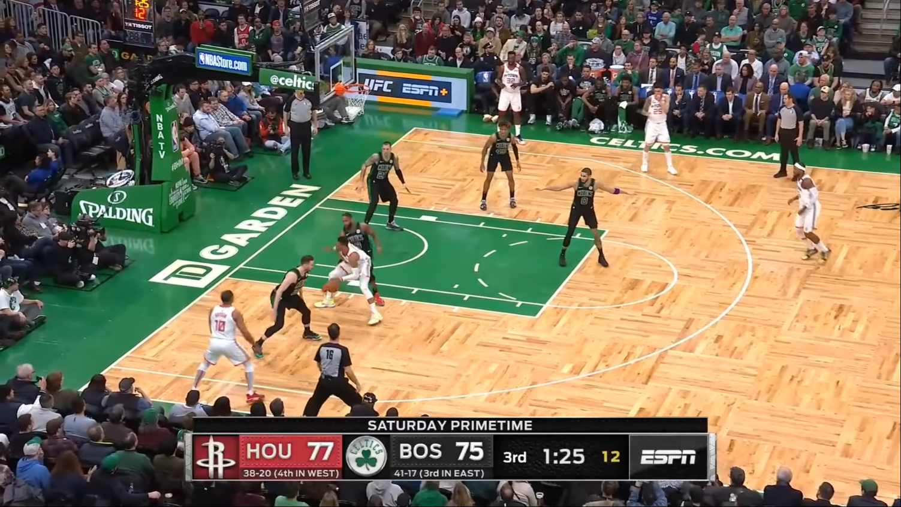
29 Feb 2020
Austin Rivers: 35.6%
Ben McLemore: 40%
Eric Gordon: 31.7%
Jeff Green: 35.4%
Russell Westbrook: 25.5%

Slide 12
Questions
Does outshooting your opponent = win?
Does making more 3s than your opponent = win?
Does having a higher 3PT % than your opponent = win?
Does shooting the 3PT well(>=50%) = win?
Does having more assists than your opponent = win?
Notice they are all Naïve Bayes Theorem.
5 questions, I shall use 1 different technique for each question for illustration purposes.

Slide 13
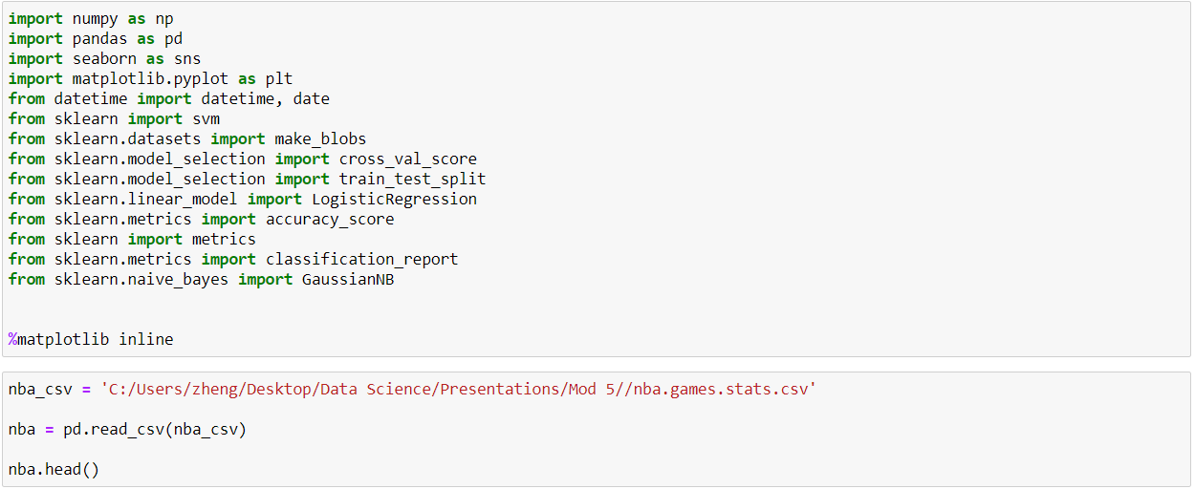
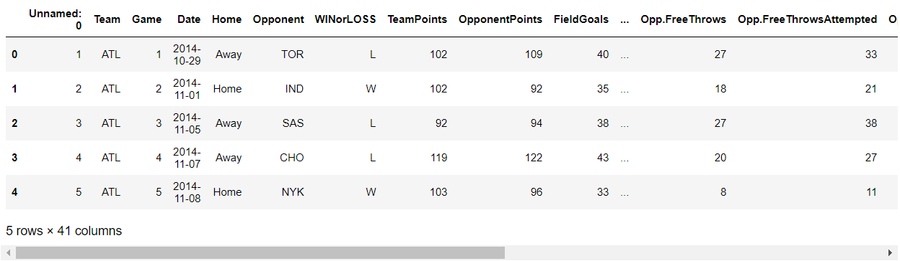
Import relevant libraries and data

Slide 14
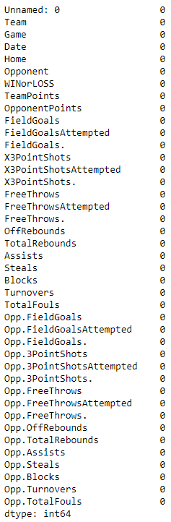
Perform EDA
nba.isnull().sum()
nba.shape
(9840, 41)

Slide 15
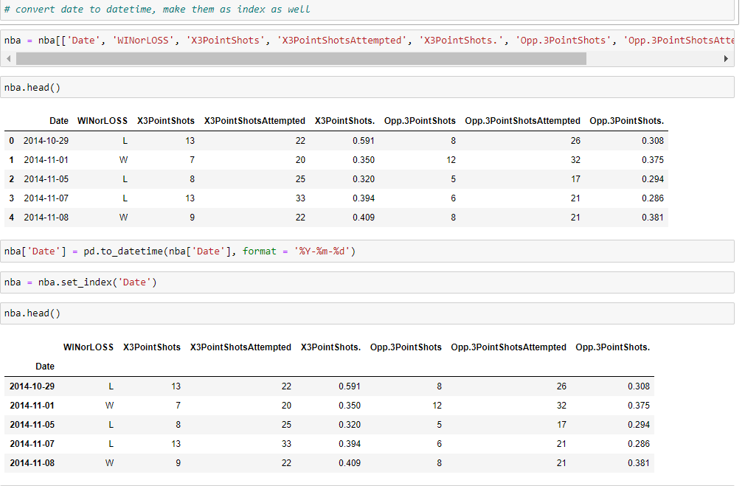
Make date as index

Slide 16
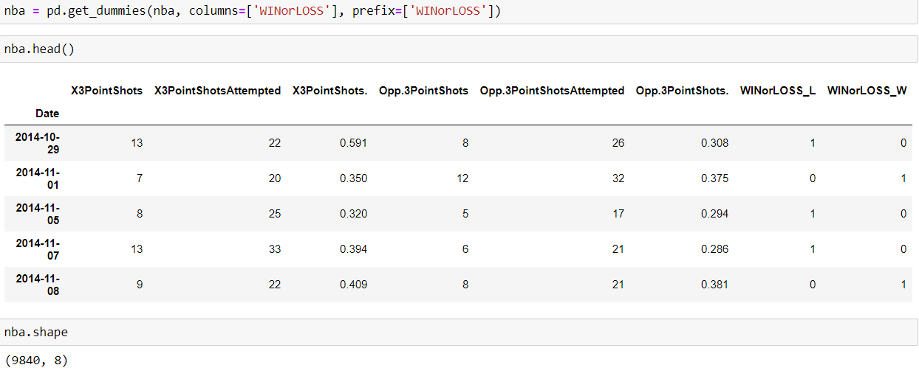
Set dummy variable for Win/Loss

Slide 17
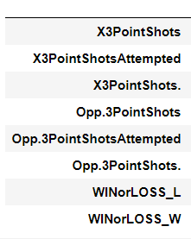
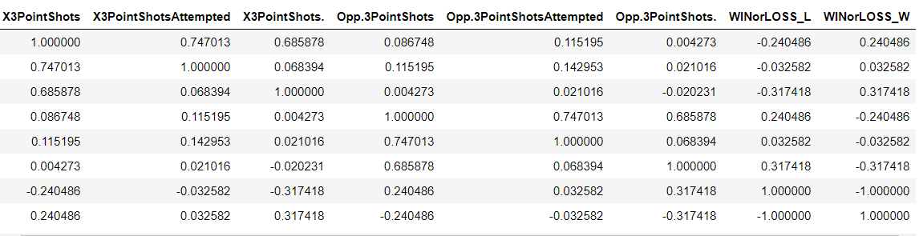
nba.corr()
Predict: This data is going to be bad

Slide 18
Trust the Process
Set target and predictor variables
Train-test-split and build model
Find accuracy score, y_pred
Construct confusion matrix
Classification report
Plot ROC curve

Slide 19
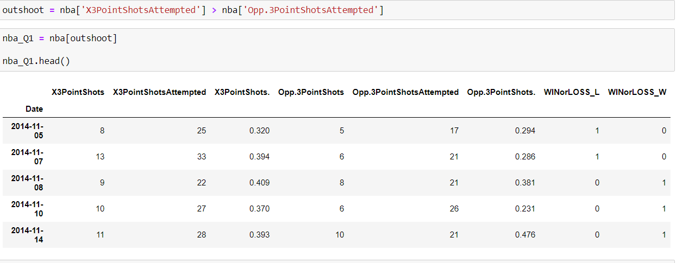
Q1 Does outshooting your opponent in 3s result = win?
We shall use Logistic Regression for this question

Slide 20
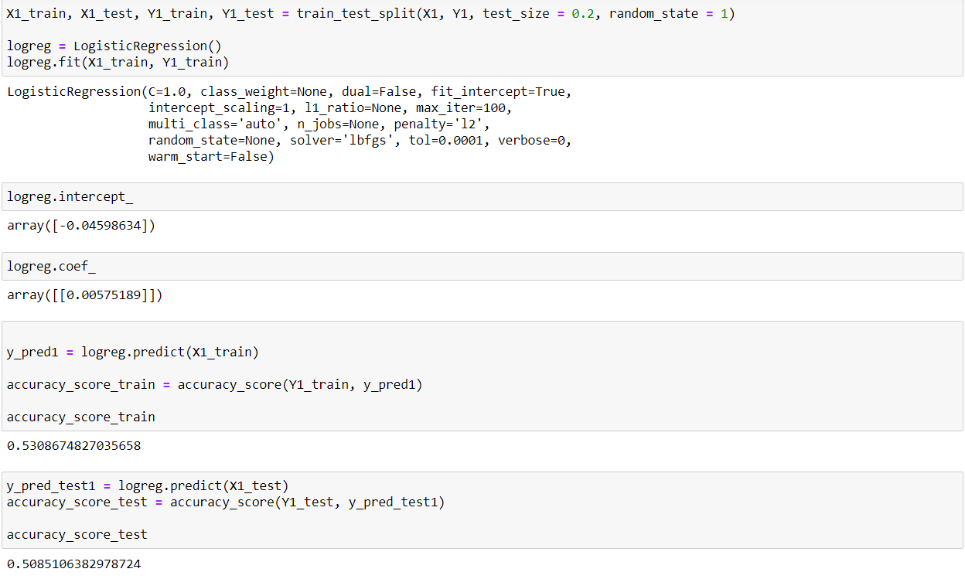
Step It Up like 1,2,3

Slide 21
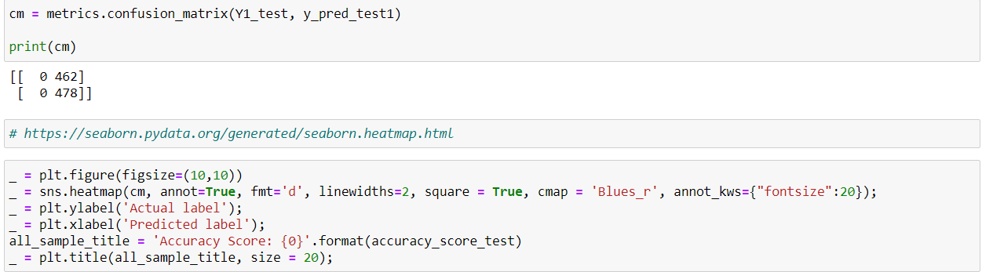
Confusing?

Slide 22
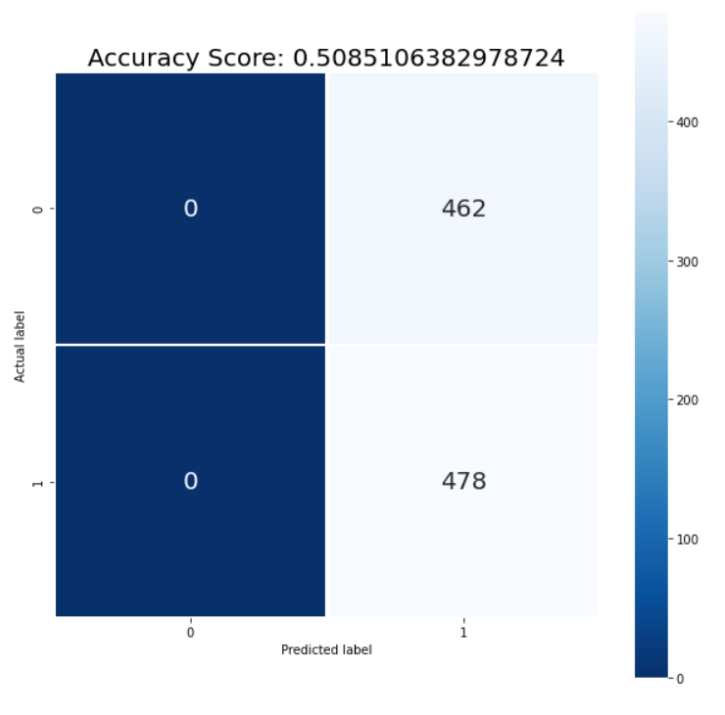
True Negative
False Positive
False Negative
True Positive

Slide 23
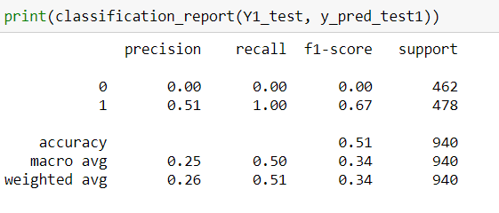
Report please
Recall(no pun intended):
Precision : How good at predicting positive outcomes when it’s actually positive - TP/(TP+FP)
Recall : How good at predicting actual positive outcomes - TP/(TP+FN)

Slide 24
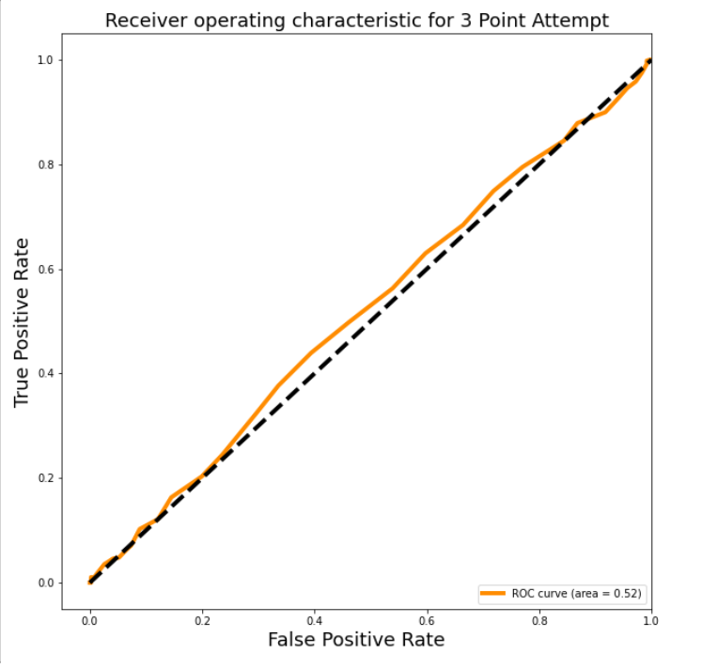
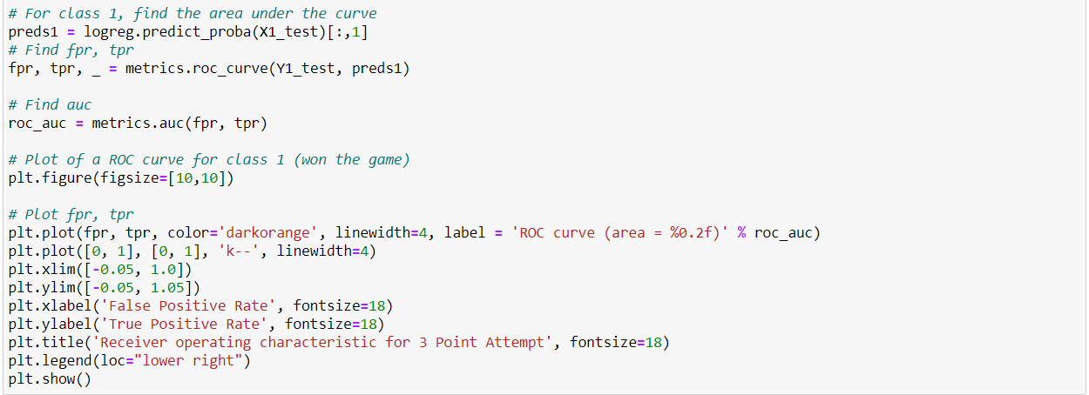
ROC that curve

Slide 25
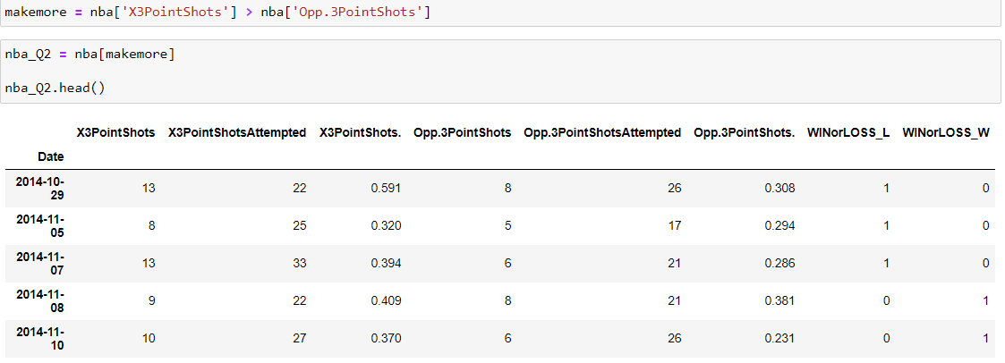
Q2 Does making more 3s than your opponent = win?
We shall use SVM Linear for this question.

Slide 26
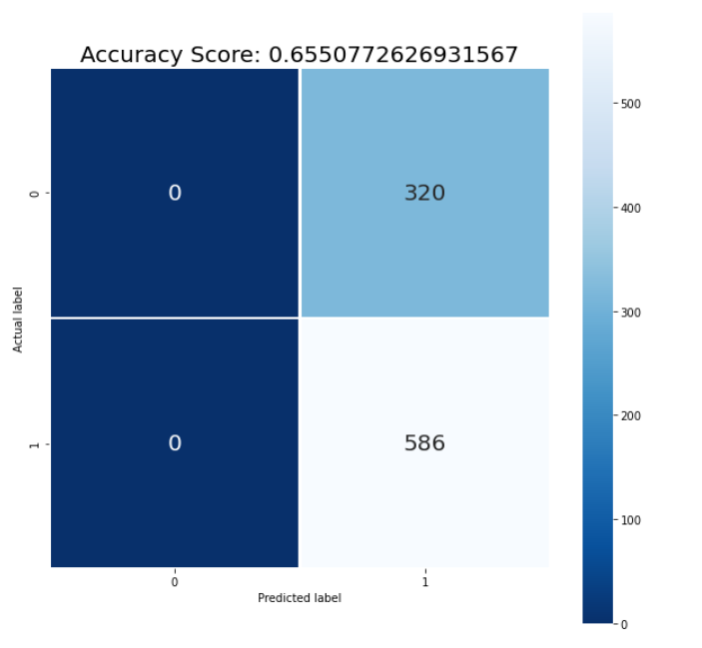
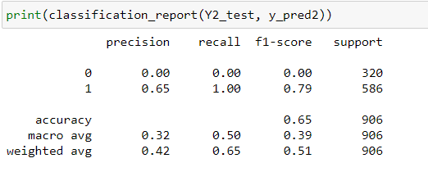

Slide 27
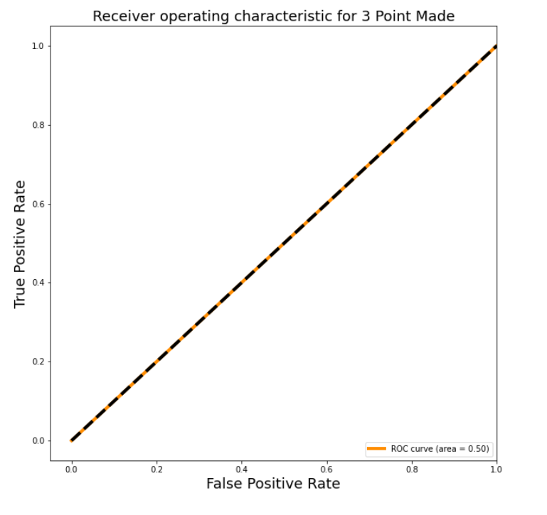

Slide 28
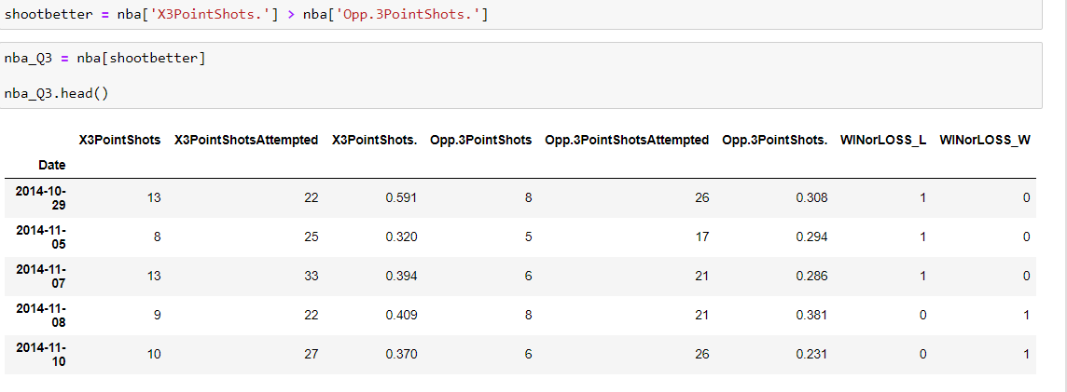
Q3 Does having higher 3PT% than your opponent = win?
We shall use non-linear SVM for this question.

Slide 29
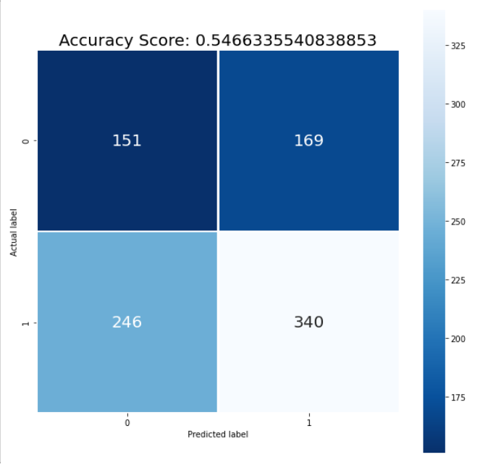
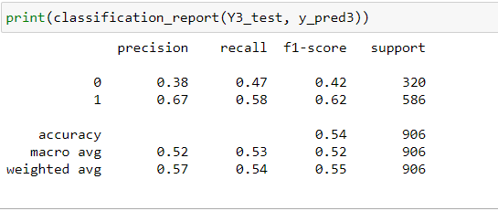

Slide 30
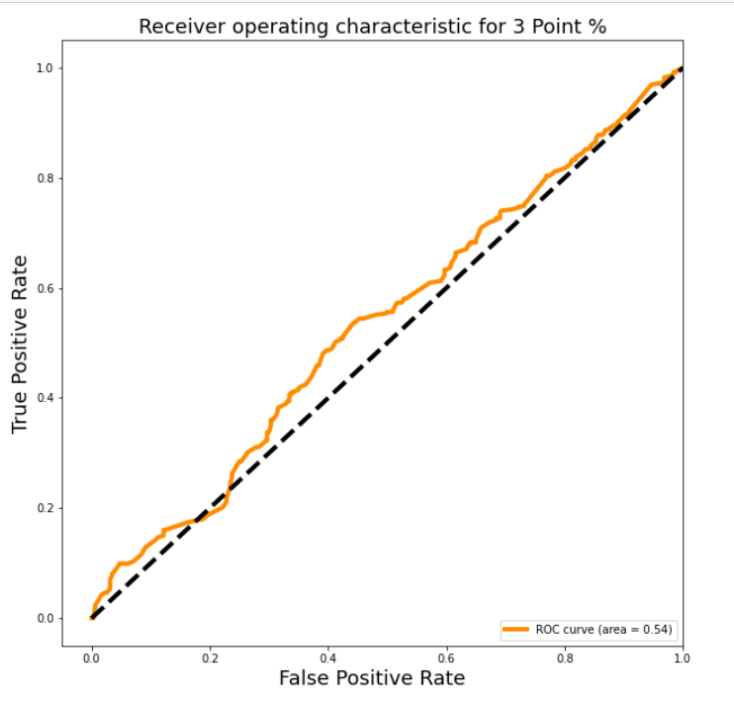

Slide 31
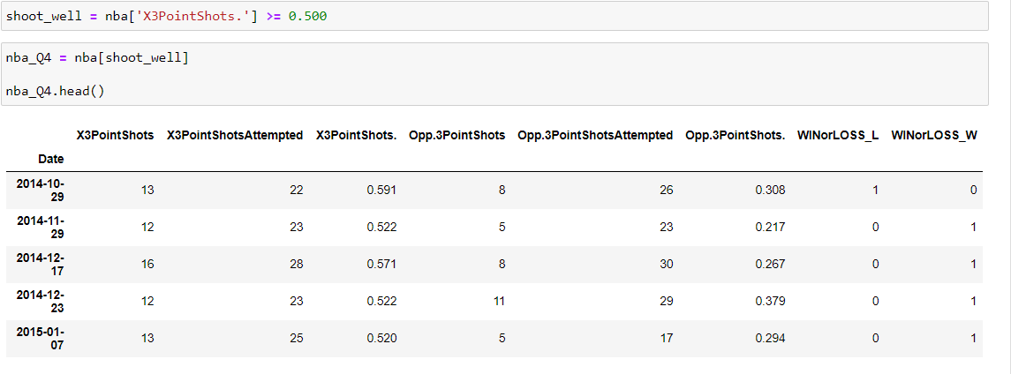
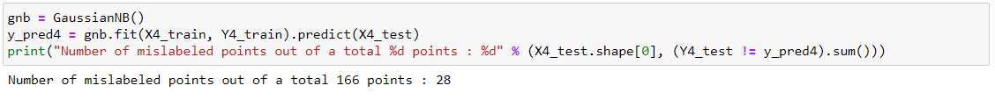
Q4 3PT% >= 50% = win?
We shall use Naive Bayes to tackle this question.

Slide 32
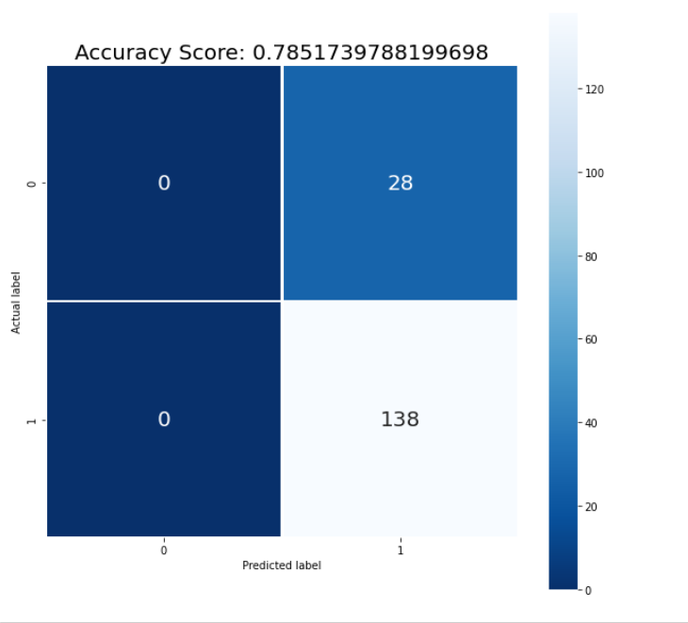
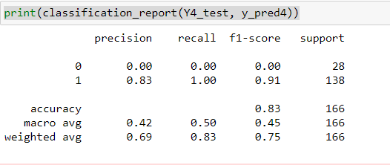

Slide 33
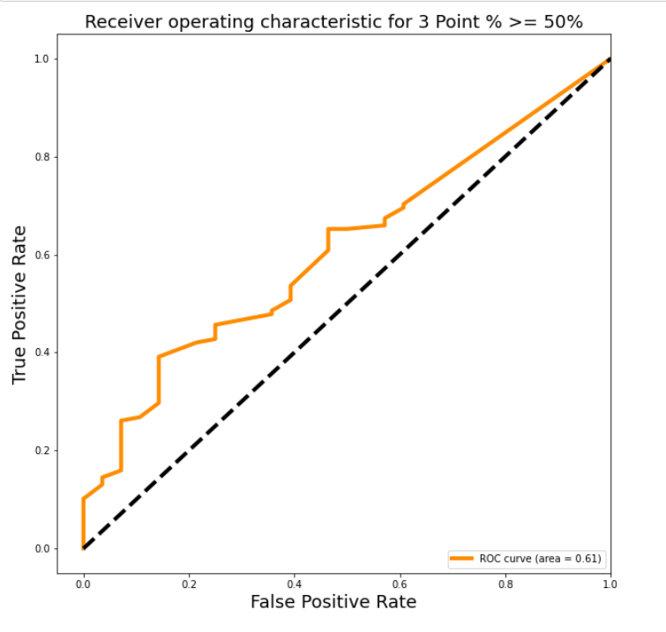

Slide 34
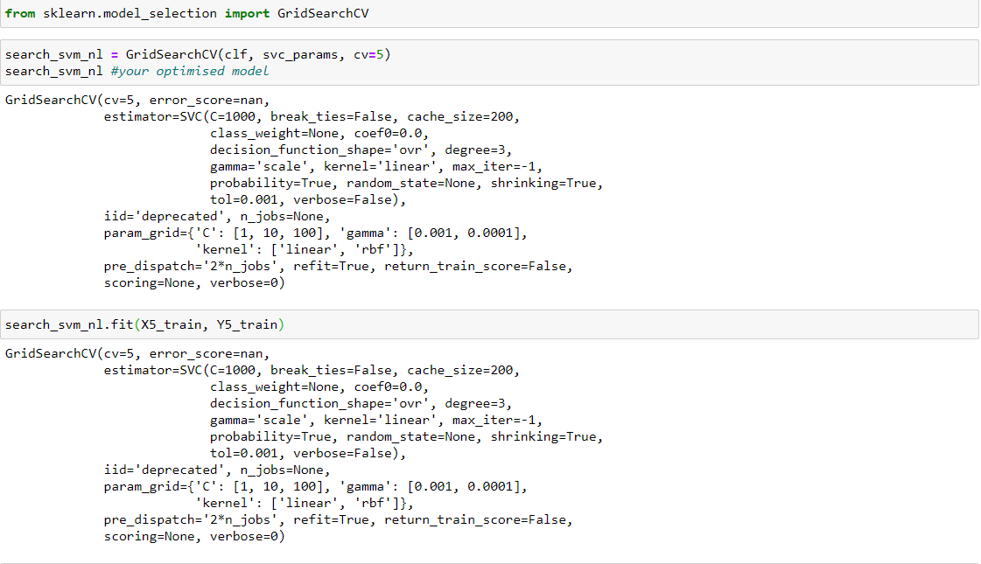
Q5 More assists than your opponent = win?
I shall use the GridSearch Method

Slide 35
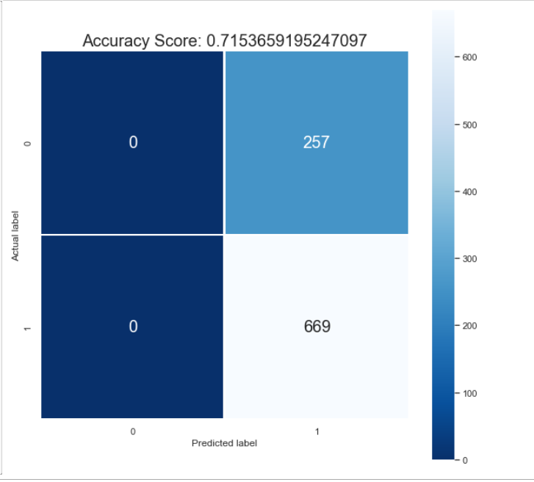
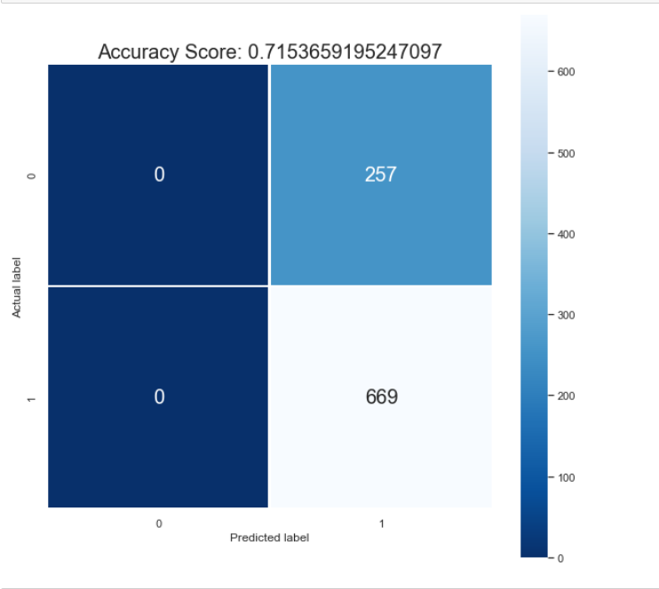
GridSearch(Linear) vs Naïve Bayes

Slide 36
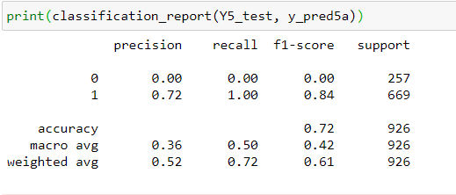
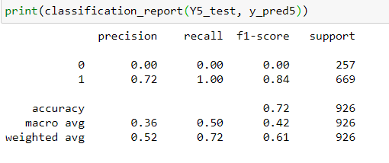

Slide 37
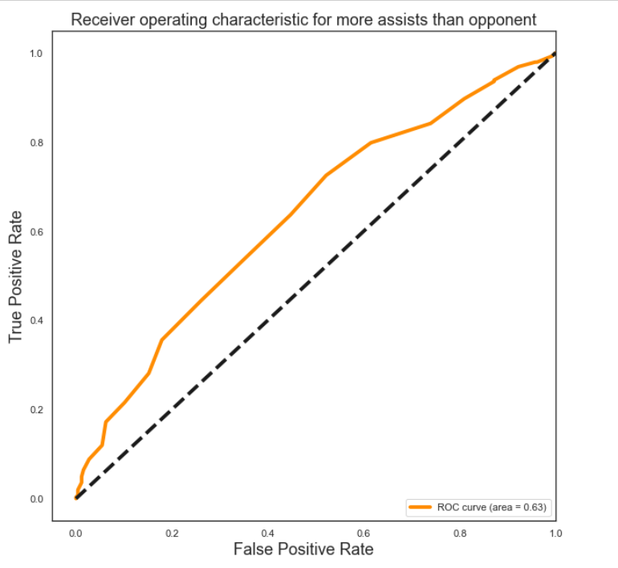
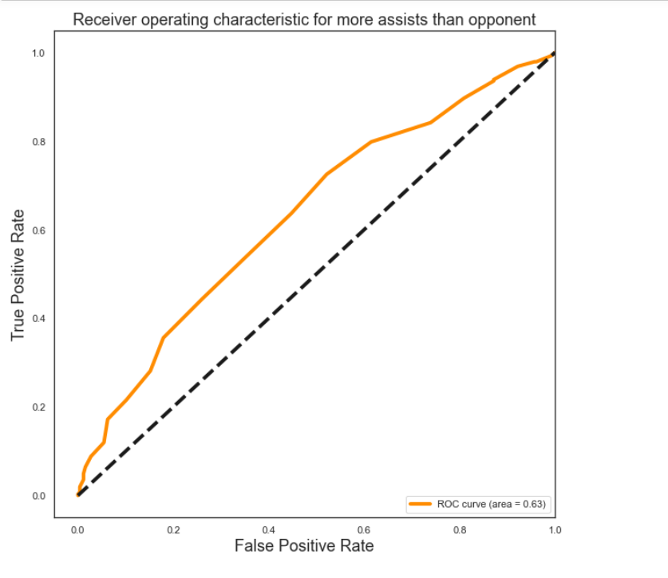

Slide 38
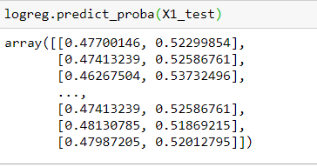
Analysis
Given that it’s true when P>= 0.5,
For Q1,2,4,5 – it is expected that the team would go on to win when the criteria is fulfilled
Using logistic regression is probably not the preferred way for analysis

Slide 39
Conclusion
Naive Bayes appears to be the best method for classification
It appears shooting more 3s does not translate to wins
Then again ROC value is relatively low
Lack of advanced data e.g quality of shots, individual stats
Future Work: Look into other factors affecting the outcome
If you want to shoot your way to Ws, “live by the 3, die by the 3”

Slide 40
If you wanna find out more…
https://www.espn.com.sg/nba/story/_/id/28312678/how-deep-audacious-3-pointers-taking-nba

Slide 41
References
https://www.kaggle.com/ionaskel/nba-games-stats-from-2014-to-2018
https://www.basketball-reference.com/leagues/NBA_stats_per_game.html
https://cheezburger.com/8244485/damian-lillards-apathetic-victory-stare-is-getting-rightfully-memed
https://www.theringer.com/nba/2019/2/27/18240583/3-point-boom-nba-daryl-morey
https://www.youtube.com/watch?v=583U6pE6ovQ
https://www.youtube.com/watch?v=uqNI4WZGSgU
https://www.youtube.com/watch?v=bI1eM2NeVyA
https://www.basketball-reference.com/teams/HOU/2020.html

